Slide 1

HAAR Cascade in contrast to LBPH (Local Binary Pattern Histogram)
NSUT EAST CAMPUS

Slide 2



Group Name : The Pythoneers
Ayaan Lone
03110102719
Tanya Goyal
00710102719
Raghav Gupta
02810102719
Assisted/Guided by:
Dr. Ram Shringar Raw

Slide 3
OBJECTIVES
To differentiate between Haar Cascade and LBPH algorithm.
To demonstrate face detection with Haar Cascade Algorithm.
To demonstrate face recognition with LBPH Algorithm.
To combine both the algorithms for creating a Face Recognition system.

Slide 4
INTRODUCTION TO THE PROJECT
The primary goal of our project is to use everyday problems to illustrate and contrast both the face detection and face recognition algorithms.
The algorithms used are HAAR Cascade and LBPH where the Haar Cascade method can recognize a variety of objects like animals, automobiles, in addition to human faces. In this project, we will be detecting the faces of the people taken through the web cam and through the live video setup.
After collecting data successfully, we will use the LBPH algorithm to train our model against the data set and then we will initiate the face recognition system.

Slide 5




TECHNOLOGIES USED
Python
VScode
Jupyter Notebook
OpenCV
Machine Learning Algorithms
Pickle

Slide 6

Haar Cascade Algorithm
(Also known as Viola Jones Algorithm)

Slide 7
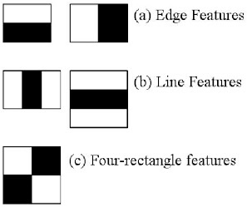
Haar Cascade Algorithm
Introduced in 2001, it is the first Object detection algorithm
Though most commonly used to detect faces, it can be trained to detect other objects also.
Features: -
Robust: Very high true positives, and low false positive
Can be used in real time
Used to detect objects (faces), not for recognition.

Slide 8

What is Haar Cascade Classifier ?
It is an object detection algorithm. It has 4 stages:-
Haar feature selection
Creating Integral images
Adaboost training
Cascading classifiers
Input Image
Integral Image
AdaBoost Training
Cascading Classifiers
Haar Feature Selection

Slide 9
1. Haar Feature Selection
The placement of the nose, brows, lips, and other basic facial structures and features are common to all human faces.
Darker around the eyes than the upper cheeks brighter around the nose bridge than the eyes
Oriented gradients of pixel intensities known as Haar features values can be used to map these regularities.
They assist in identifying regions where the pixel intensities suddenly change.

Slide 10
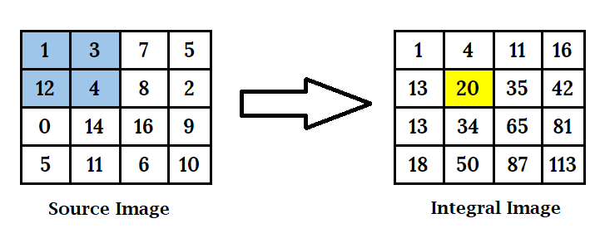
2. Creating Integral Image
The total of the pixels above and to the left of (x, y), inclusive, makes up the integral image at position (x, y).
As a result, the final pixel in the bottom-right corner would represent the total number of pixels in the original image.

Slide 11
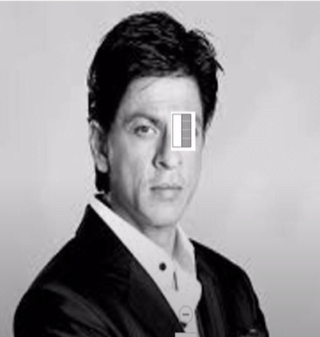
3. Training with AdaBoost
AdaBoost is a supervised machine learning algorithm, and its task in this case is to determine the ideal placement for each Haar feature.
It will begin at the very first pixel in the top-left corner and move across until it finds the best fit (as shown in the image to the side), after which it will move up to the bottom-right corner.

Slide 12


Slide 13
4. Cascading
If a feature fails on a particular window, then we can say that the facial features are not present there.
Hence, we can move to the next windows where there can be facial features present.
This way a lot of processing time will be saved, as the irrelevant windows will not be processed in the majority of the stages.

Slide 14

Local Binary Pattern Histograms
(LBPH Algorithm)

Slide 15

What is LBPH
The Local Binary Pattern Histogram algorithm, which recognizes both the front and side of a human face, is a face recognition system built on a local binary operator.
Below are some important parameters required for LBPH :
Radius
Used to Build the circular local binary pattern.
Represents the radius around the circle
Usually Set to 1.
Neighbors
Number of sample points to build the circular local binary pattern.
Usually Set to 8.
Grid X and Y
Number of cells in Horizontal and Vertical Direction
Usually set to 8.
More cells = higher dimensionality of the resulting vector.

Slide 16

How does the LBPH Algorithm work?
It consists of the following steps:-
Training the algorithm
Applying LBP operations
Extracting histograms
Performing face recognition

Slide 17

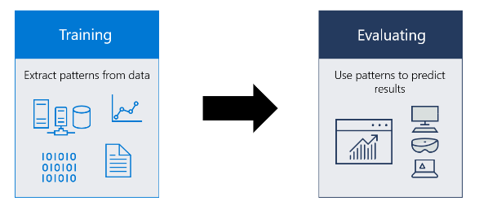
1. Training the Algorithm
Dataset is a set of labelled facial images.
This labelling can be either name or number. It is an unique ID for different individuals.
Images of the same person must have same ID

Slide 18
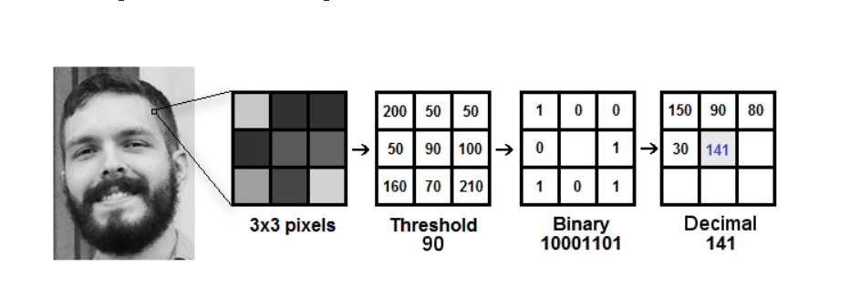
2. Applying LBP operation
We will create an intermediate image that would describe the original image in a better understandable way.
For doing this, we use the concept of sliding window.

Slide 19
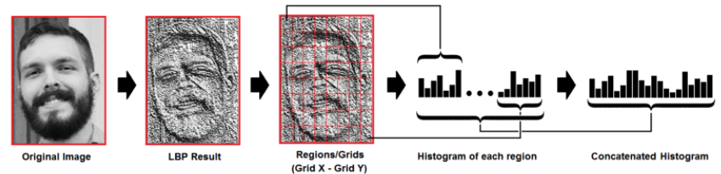
3. Extracting Histograms
Several histograms are created . The next step is to combine each histogram into a single, larger histogram. The characteristics of the original image are reflected in the final histogram.

Slide 20

4. Performing Face Recognition
Each histogram produced serves as a representation of one of the training dataset's images.
Using an input image as a starting point, we repeat the steps to create a new image, and then we create a histogram to represent that new image.
Therefore, all that is required to locate the image that corresponds to the input image is to compare two histograms and return the image with the closest histogram.

Slide 21
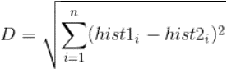
How can we compare histograms ??
We locate the closest histogram, which is nothing more than a representation of the image's facial features, using Euclidean distance.
Additionally, we can provide the calculated Euclidean distance. This serves as a gauge of assurance.
A lower value indicates that the histograms are more similar and are thus closer together.

Slide 22
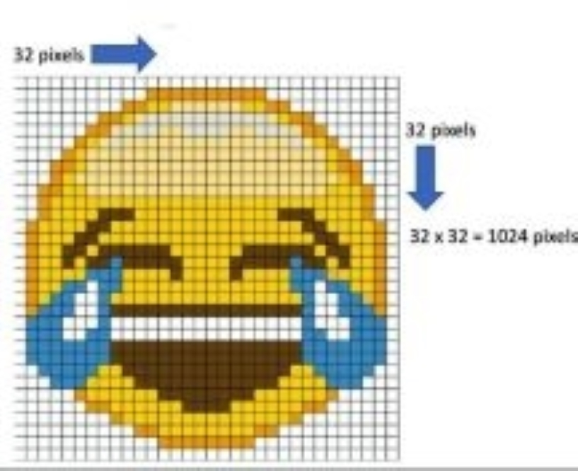
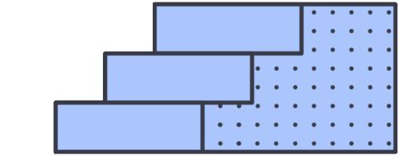
Step by Step Implementation of Haar Cascade Algorithm

Slide 23
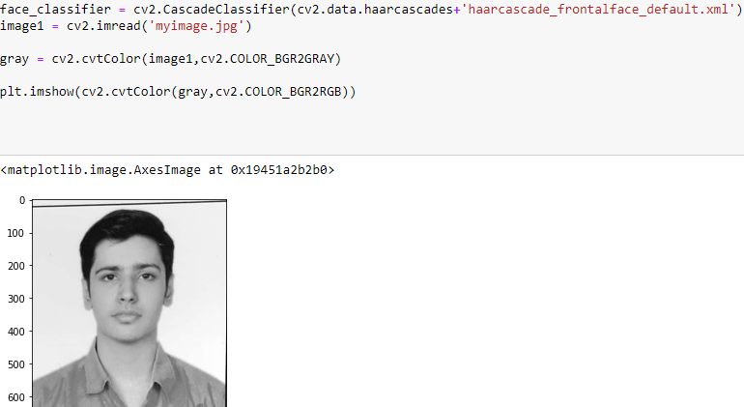
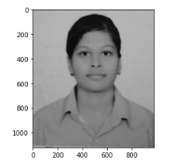
Step 1 :
A face classifier object is created.
The Image is Converted to Grayscale using OpenCv to reduce it’s size as well as increase the accuracy of the code.

Slide 24
Step 2 :
Face Classifier detects the faces in the Grayscale Image by using the suitable parameters provided by the user itself.
It requires two parameters: scaleFactor and minNeighbors.

Slide 25
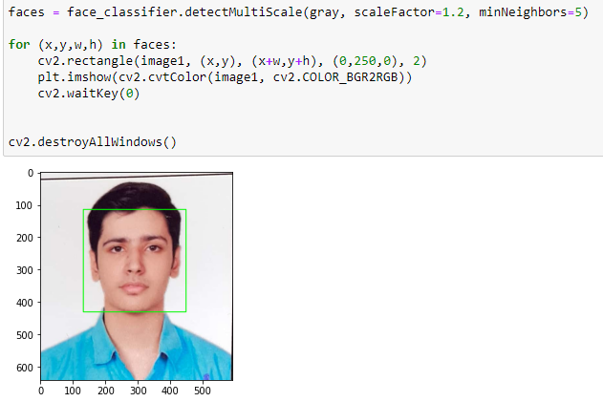
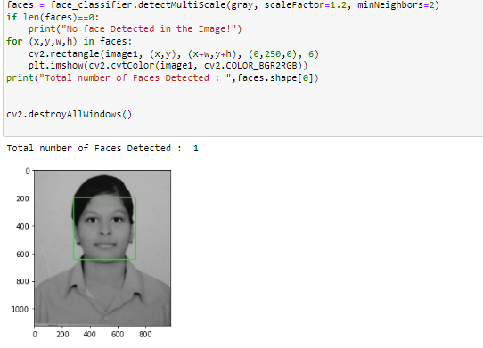
Step 3:
After the algorithm has detected the faces, it returns an object that contains the appropriate values and coordinates for the face that is present in the image and using those coordinates, we create a rectangle around the face indicatintrg the presence of a human face in the provided image

Slide 26
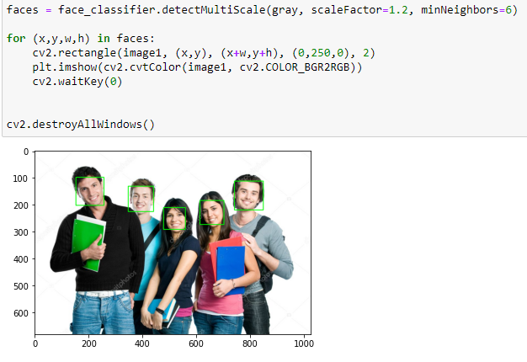
It can detect Multiple faces in a Single Image !!
(Applying the Algorithm on an Image with a single Human Face Present in it.)
(Applying the Algorithm on an image with Multiple Human Faces Present in it.)

Slide 27
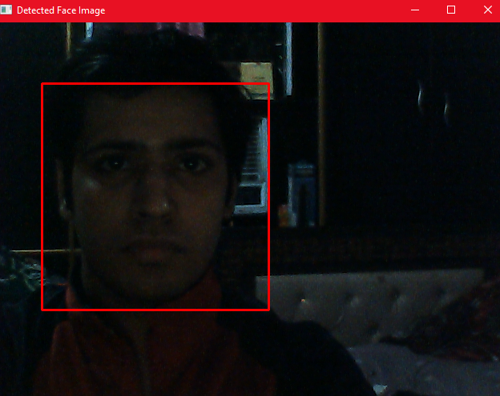
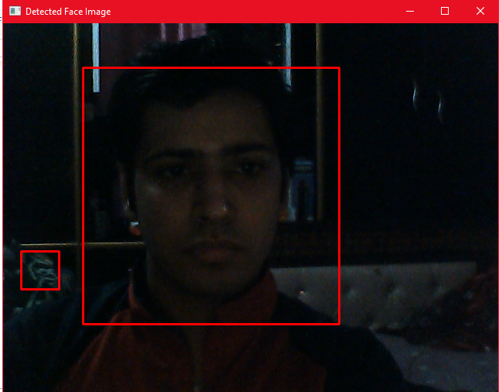
Observations
Parameters : minNeighbor = 5
Parameters : minNeighbor = 2

Slide 28

Observations:
As we can see in the above two captured images, by setting the minNeighbors parameter as 5, the algorithm detected the face precisely and there was no error in finding out the exact location of the face detected.
Where as when this parameter was set to 2, the algorithm detected another coordinates that did not contain any human face but still it created a rectangle around it.

Slide 29
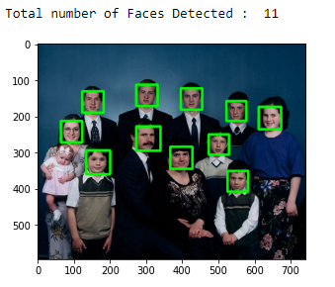
We can also count the number of Faces !!:
Here we can see that the total number of Faces detected is 11 where as total faces present is 12
This is due to the fact that the Haar cascade frontal face xml file provides sufficient data to detect the front face that means the front face including the eyes and other facial features of the person. The child in the following image is not directly looking into the camera and it’s eyes and face are detectable.

Slide 30

Data Generation
For our further observations, we would be using our own generated dataset and we will train our model against that captured dataset.
Data Would be captured as greyscale images and using the Haar Cascade, the system would make sure that It will only collect data that is relevant i.e. Human faces.

Slide 31
Steps for Dataset Generation
Takes Username as input and appends the pickle file.
Crops and Captures the Subject Face in GrayScale.
Image is saved in .jpg format
1
3
5
2
4
6
Uses Haar Cascade to Detect Human Face present in the Video.
Opencv writes the image file in the “Data” folder.
Label of the Image consists of username, image serial number and the Image Id.

Slide 32
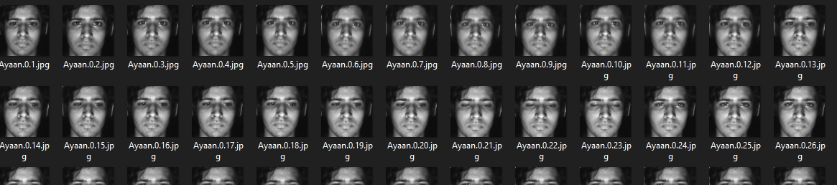
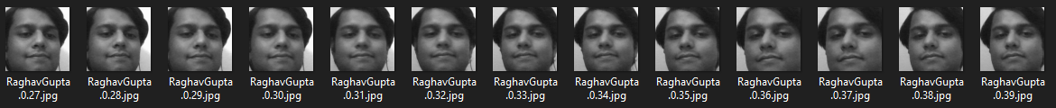
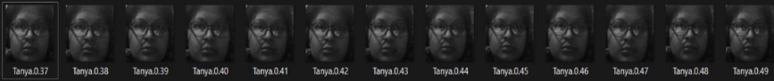
DATASET GENERATION

Slide 33
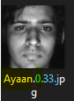


DATASET BREAKDOWN
SERIAL NUMBER
Serial Number of the captured Image
USER NAME
Name of the Respective user Collected before capturing the Image
.jpg is the picture format used in our Dataset
FORMAT
Id of the subject image that would later on be compared with the list in the Pickle File.
IMAGE ID

Slide 34
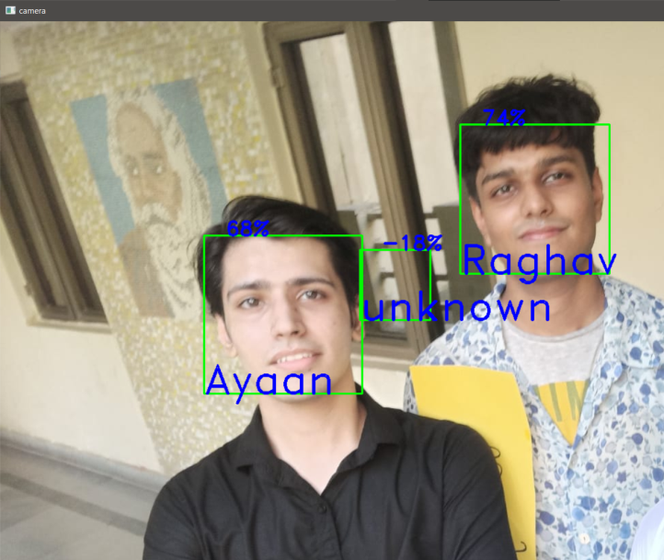
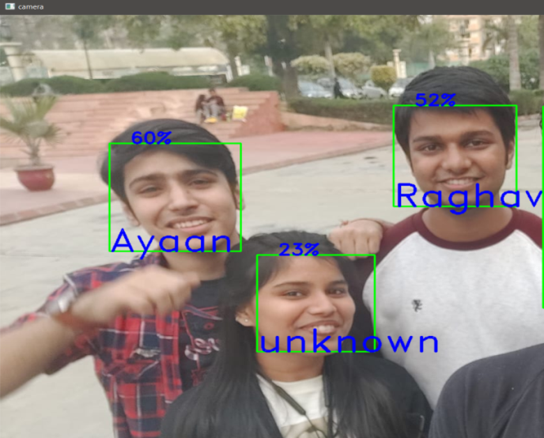
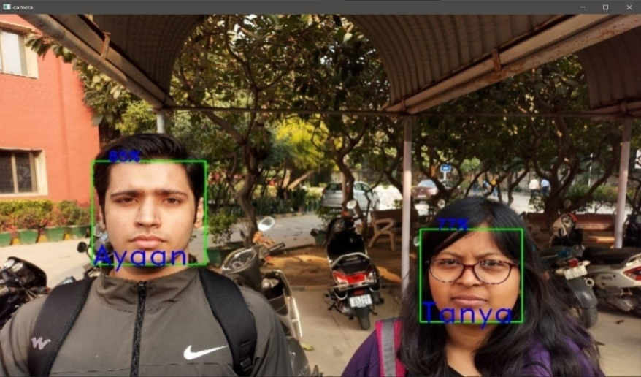
OBSERVATIONS !!

Slide 35
Laptop Camera (0.92 MP 1280×720)
Serial Number | Number of Images | Confidence Obtained (Single Person) | Confidence Obtained (Multiple Subjects)
1 | 10 | 30% - 34% | <30% (Incorrect Results)
2 | 50 | 55% - 58% | <55%
3 | 100 | 60% - 63% | <57%
4 | 500 | ≈64% | <61%

Slide 36
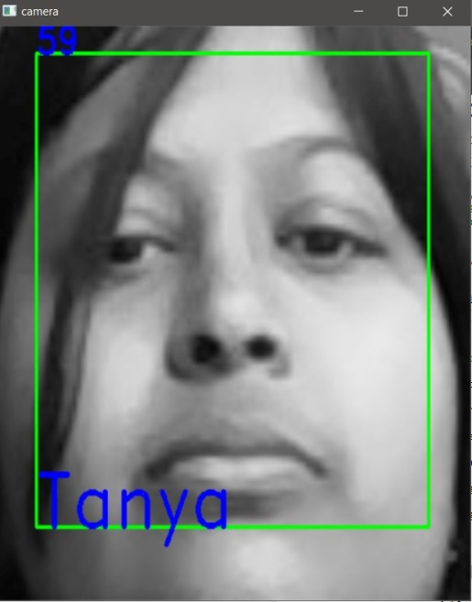
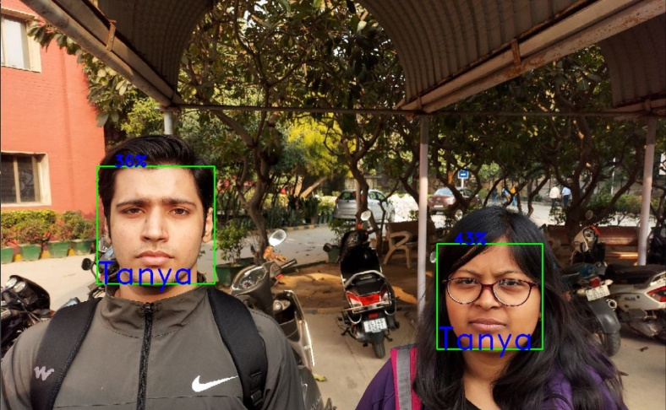
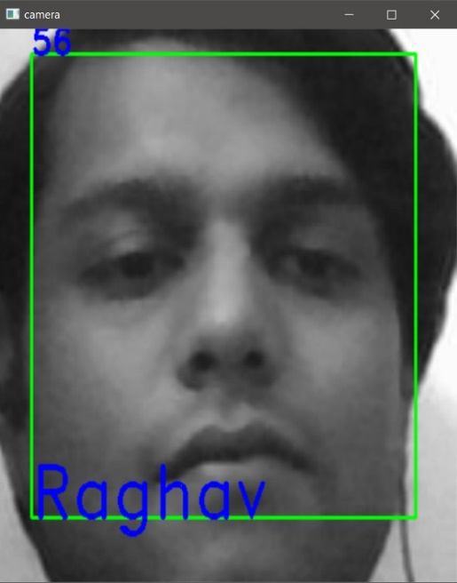
Observations(Laptop Camera)

Slide 37
Smart Phone Camera
Serial Number | Number of Images | Confidence Obtained (Single Person) | Confidence Obtained (Multiple Subjects)
1 | 50 | 54% - 58% | ≈60%
2 | 100 | 65% - 67% | <68%
3 | 500 | 65% - 77% | <85%

Slide 38
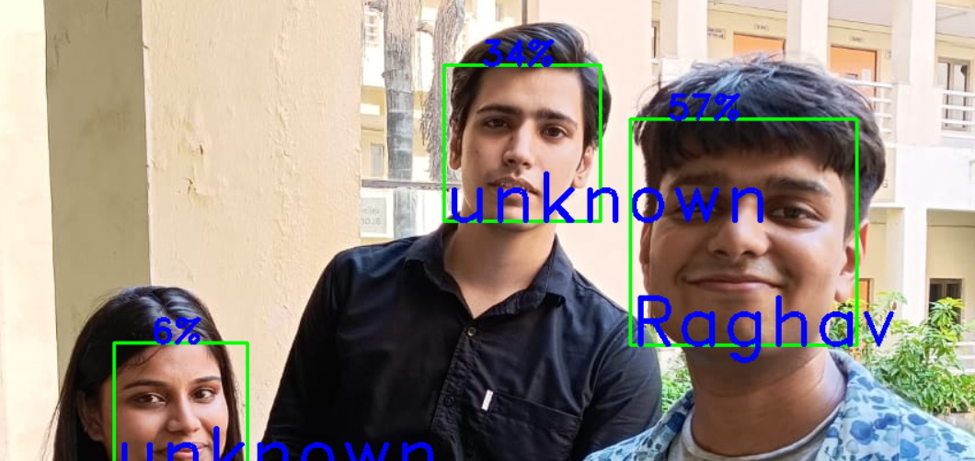
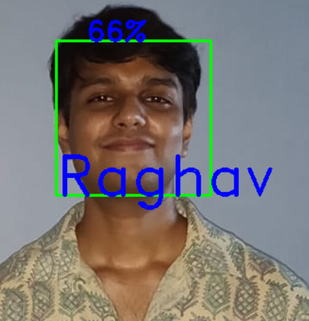
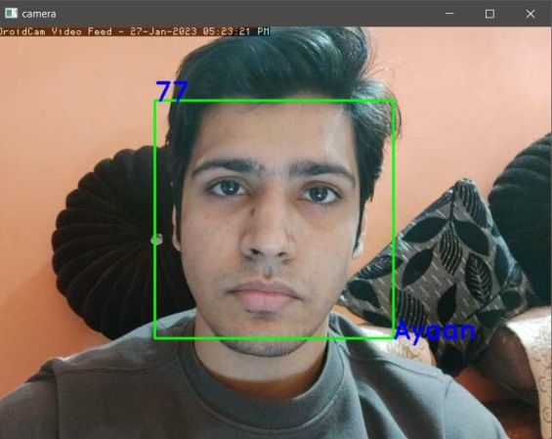

Slide 39
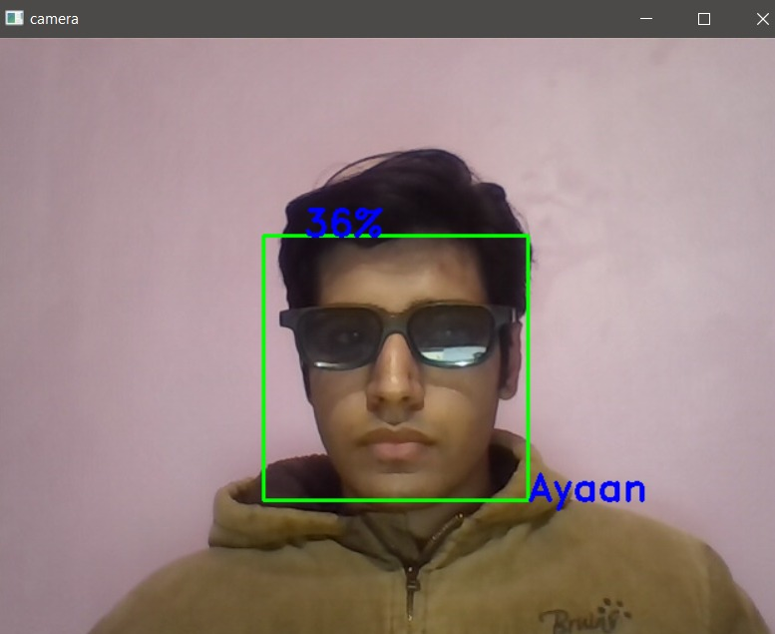
Accessories!!
We’ve even tested our model against some challenging situations such as when the subject is wearing some accessories and we can clearly see that the accuracy has dropped drastically when such conditions are involved in the testing. These situations can be tackled by training the model against the dataset which includes the same person wearing accessories as well as changing the distance between the camera and lighting conditions should be kept in mind as well. A blunt dataset with similar angle and lighting conditions would not be preferred as a good dataset to be trained upon.

Slide 40
External Webcam
Serial Number | Number of Images | Confidence Obtained (Single Person) | Confidence Obtained (Multiple Subjects)
1 | 50 | 50% - 58% | ≈55%
2 | 100 | 60% - 64% | <66%
3 | 500 | 65% - 77% | <85%

Slide 41
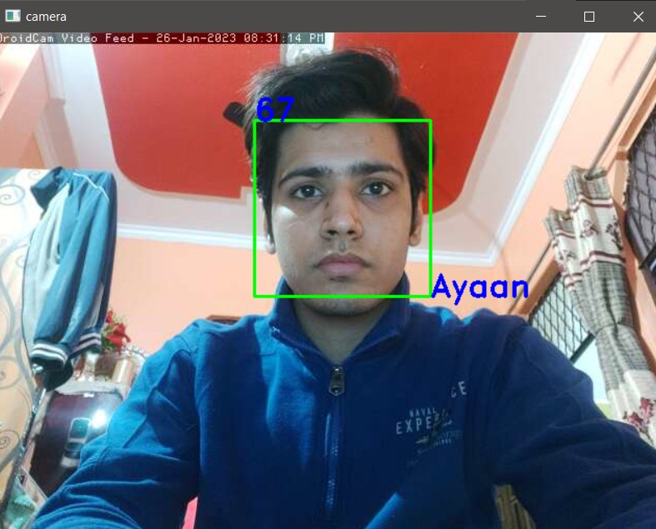
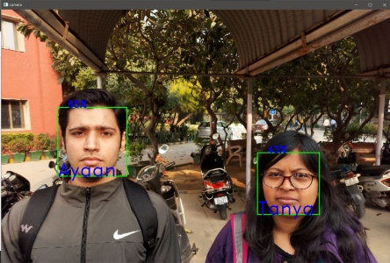
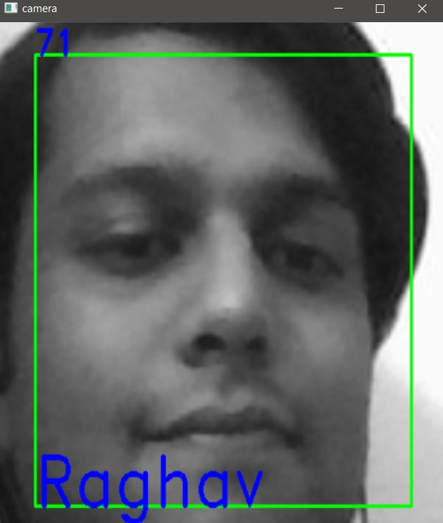
The external camera provided slightly better observations than the laptop's internal camera, but they were still comparable to or nearly equal. No such pronounced change in accuracy could be observed.

Slide 42
CONCLUSION !!
At the conclusion of this project, we were able to compare, contrast, and successfully implement the algorithms LBPH and Haar Cascade with the necessary observations, taking into account a variety of challenging scenarios. We furthermore stated the ideal circumstances for each algorithm to achieve the best results. The results of this project clearly demonstrate that both LBPH and Haar Cascade algorithms are effective tools for facial recognition and have the potential to be used in numerous applications ranging from security systems to healthcare. The insights from this project can be used to inform further research into facial recognition technology, as well as the development of more sophisticated algorithms. This project has been a great learning experience that has allowed us to gain an in-depth understanding of facial recognition technology, and how LBPH and Haar Cascade algorithms compare.

Slide 43


Resources:
https://towardsdatascience.com/
www.youtube.com
https://www.analyticsvidhya.com/
https://docs.python.org/3/library/tk.html
https://realpython.com/python-gui-tkinter/
https://www.geeksforgeeks.org/
https://www.javatpoint.com/
https://www.section.io/
https://www.hindawi.com/journals/cin/2022/4515642/
https://ieeexplore.ieee.org/document/8776934
https://docs.opencv.org/3.4/db/d28/tutorial_cascade_classifier.html
https://www.slideshare.net/SmritiTikoo/face-detection-62383927
https://docs.opencv.org/2.4/modules/contrib/doc/facerec/facerec_tutorial.html#local-binary-patterns-histograms

